Slide 1



X
QA Engineer Final Project
Jubelio Quality Assurance Engineer Virtual Internship
Presented by
Muhammad Rafi Ediananta

Slide 2


Muhammad Rafi Ediananta
Insert Your Experience
Project-Based Virtual Intern: Jubelio Quality Assurance Engineer Virtual Internship
About You
As a Telecommunication Engineering student, I have gained valuable technical experience and worked collaboratively on various projects. I possess strong leadership skills and a high enthusiasm for learning. My focus lies in the field of technology, particularly in security development and applications, such as web development and ethical hacking. Through my experiences and skills, I have received recognition and held notable positions, including serving as a research assistant at MBC Laboratory. I have also achieved satisfactory academic performance with a GPA of 3.8.
Cybersecurity Research Assistant at Multimedia Application, Big Data, and Cybersecurity Laboratory
Practicum Assistant at Basic Computing Laboratory

Slide 3
Case Study
Buatlah test case pada beberapa fitur di Jubelio:
○ User login Jubelio (Jubelio page)
○ User membuat negative test case pada login Jubelio (Jubelio page)
○ User membuat barang baru non varian pada katalog (Jubelio page)
Lakukan API testing dengan Postman pada Jubelio API:
○ Testing pada endpoint:
■ Login: Jubelio API
■ All product price: Jubelio API
■ Upload product image: Jubelio API
■ Delete product: Jubelio API
○ Lengkapi testing API dengan negative scenario (min 1 pada tiap test)
○ Buatlah test case terkait API test tersebut

Slide 4
Case Study
Buatlah Web Automation dengan Selenium Web Driver
○ Buat automation scenario pada Login flow di halaman Jubelio (Jubelio page)
○ Buat automation scenario untuk mengatur stock persediaan (Jubelio page)
Buatlah Github repository untuk web automation yang telah Anda buat
○ Buat Github account
○ Buat Github repository
○ Upload local code ke remote repository
○ Berikan step by step untuk menjalankan automation yang telah dibuat di local
○ Berikan evidence pendukung (screen record) saat menjalankan web automation tersebut di local
○ Berikan evidence (screenshot) run results (jumlah scenario dan jumlah steps) di local

Slide 5
Link Test Case:
https://rentesting.atlassian.net/l/cp/M2vesZXU

Slide 6
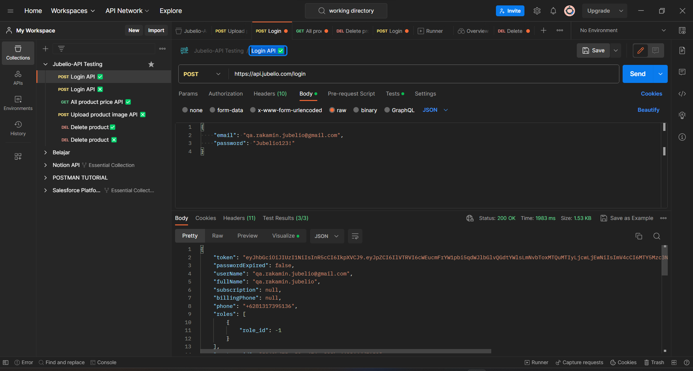

Slide 7
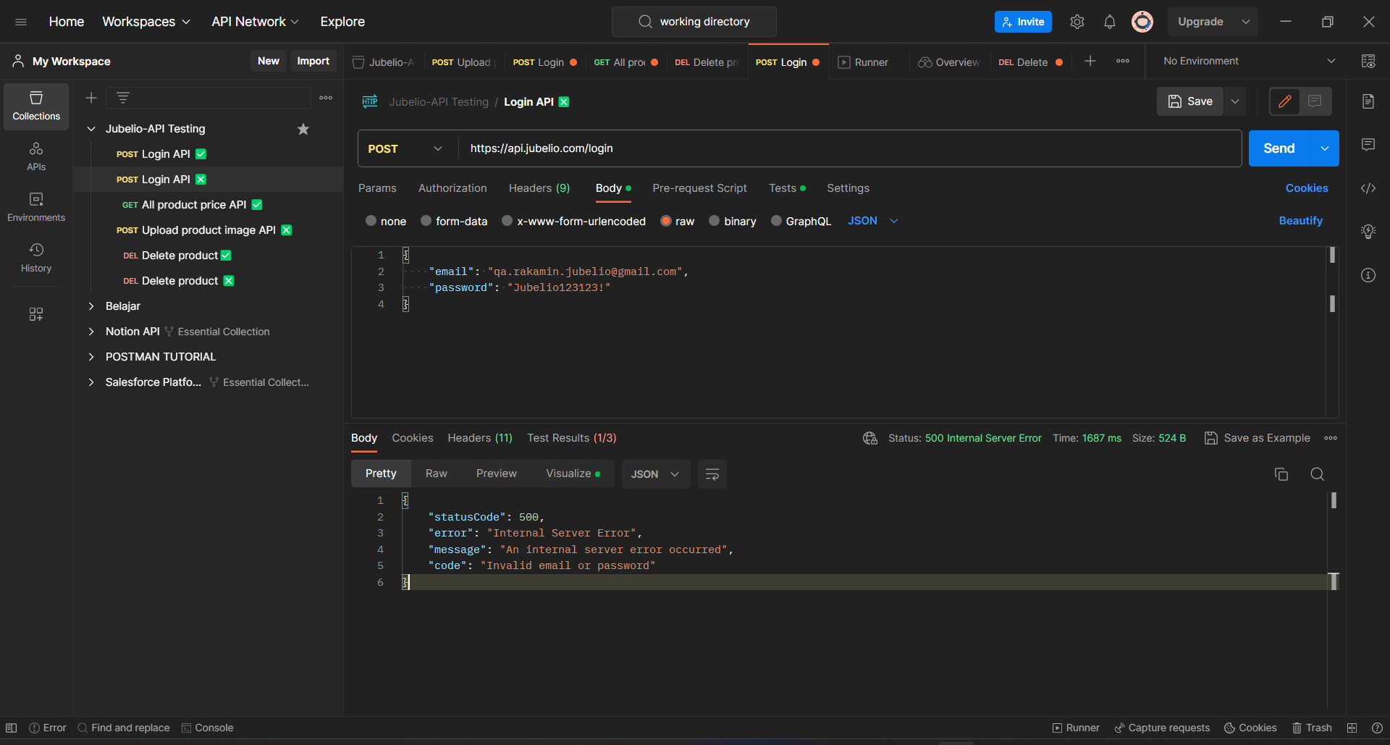

Slide 8
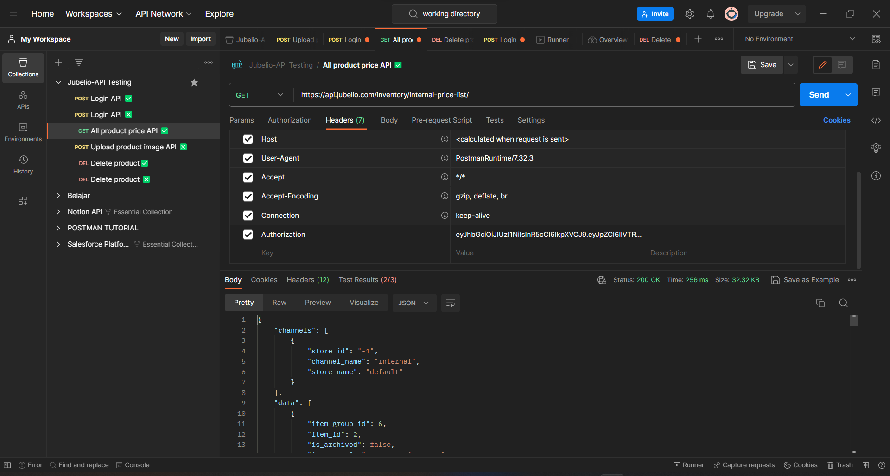

Slide 9
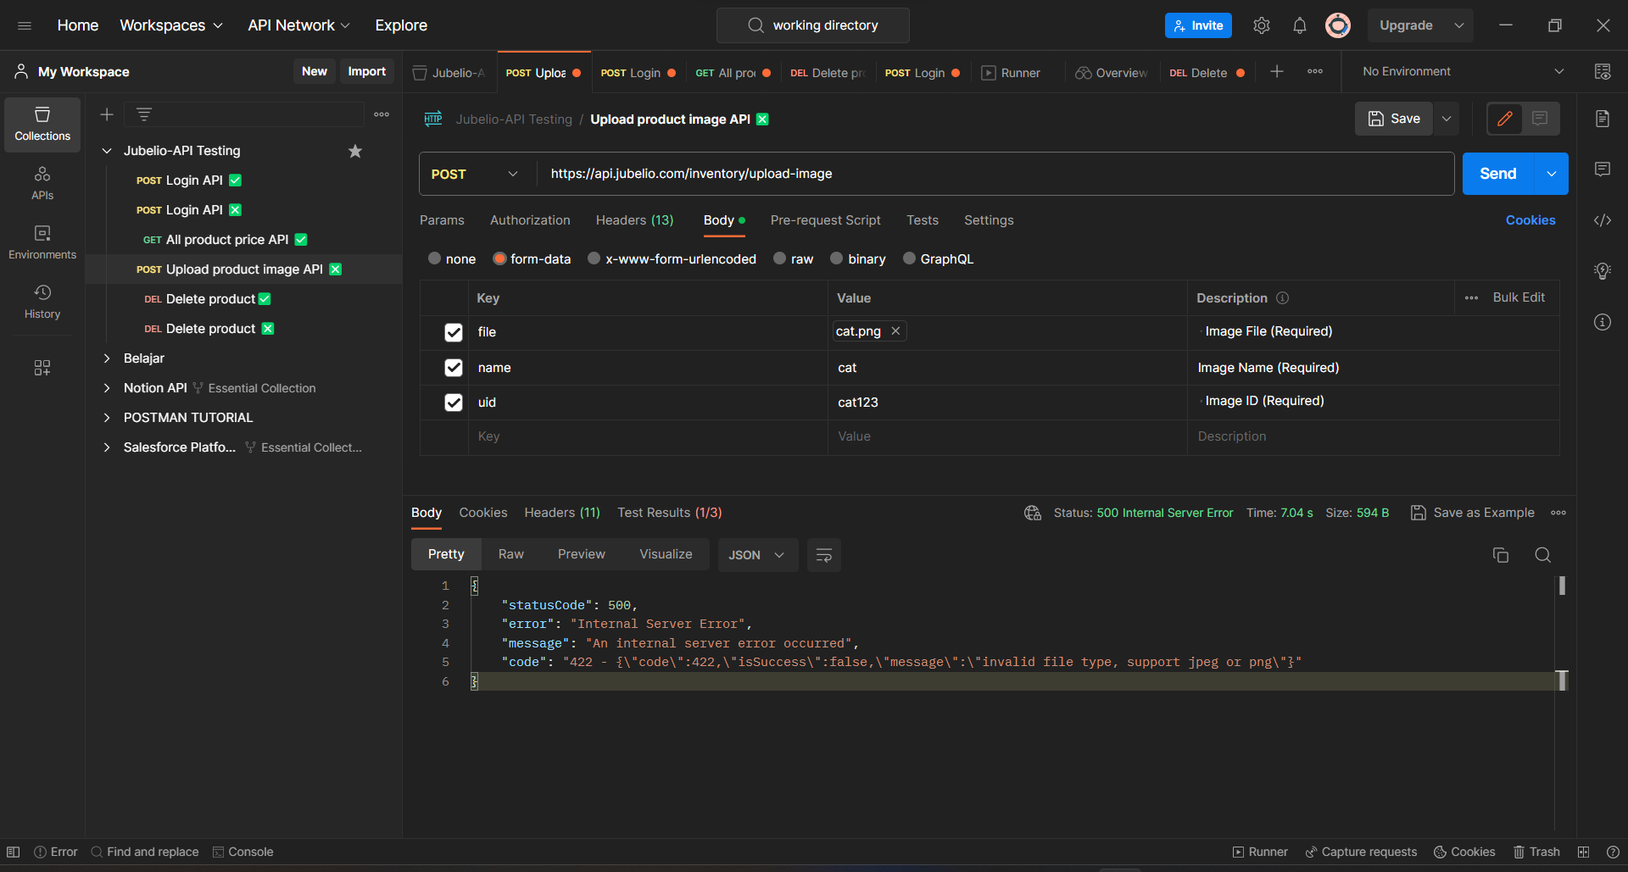

Slide 10
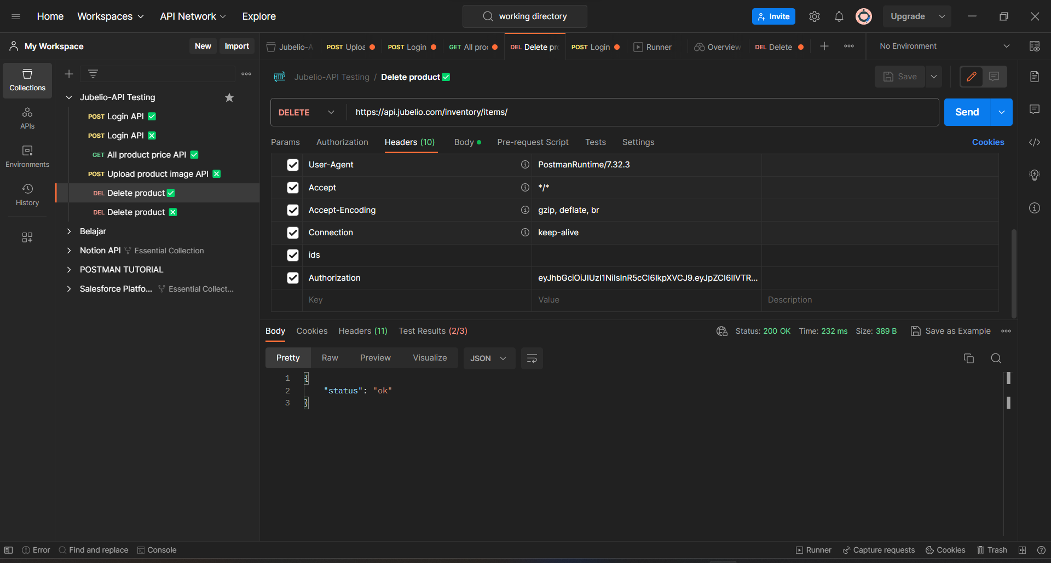

Slide 11
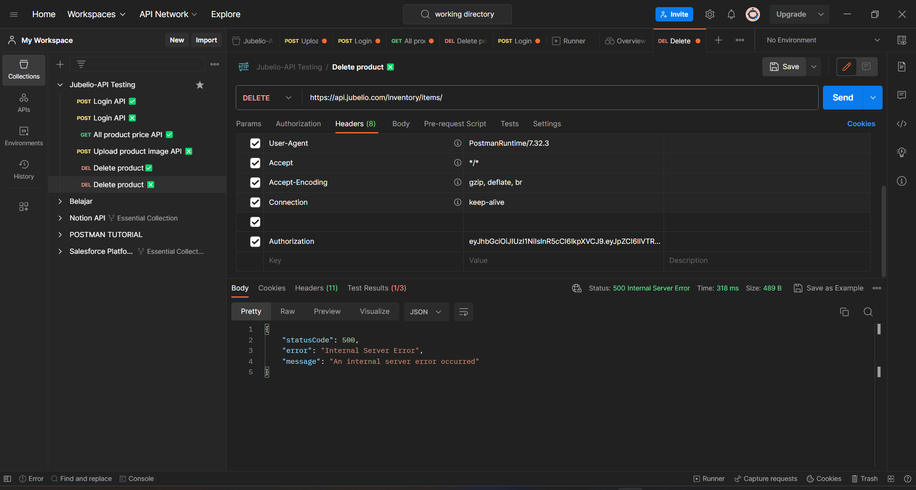

Slide 12
Insert Your Link Github Here
You can add link GitHub also (optional)

Slide 13
Video Presentation Here
Please insert your link video here (You can upload the video on YouTube or Google Drive first)!

Slide 14
Thank You
X

Slide 15

Disclaimer
Kalian dapat mengganti design template ini sesuai kreativitas kalian.
Template ini hanya bertujuan untuk memberikan gambaran isi konten yang wajib dibuat oleh peserta.

